Slide 1
Java Constructors
Java Modifiers
Encapsulation

Slide 2
Java Constructors
A constructor in Java is a special method that is used to initialize objects. The constructor is called when an object of a class is created. It can be used to set initial values for object attributes:

Slide 3
// Create a Main class
public class Main {
int x; // Create a class attribute
// Create a class constructor for the Main class
public Main() {
x = 5; // Set the initial value for the class attribute x
}
public static void main(String[] args) {
Main myObj = new Main(); // Create an object of class Main (This will call the constructor)
System.out.println(myObj.x); // Print the value of x
}
}

Slide 4
Note that the constructor name must match the class name, and it cannot have a return type (like void).
Also note that the constructor is called when the object is created.
All classes have constructors by default: if you do not create a class constructor yourself, Java creates one for you. However, then you are not able to set initial values for object attributes.

Slide 5
Constructor Parameters
Constructors can also take parameters, which is used to initialize attributes.
The following example adds an int y parameter to the constructor. Inside the constructor we set x to y (x=y). When we call the constructor, we pass a parameter to the constructor (5), which will set the value of x to 5:
Example
public class Main {
int x;
public Main(int y) {
x = y;
}
public static void main(String[] args) {
Main myObj = new Main(5);
System.out.println(myObj.x);
}
}

Slide 6
Modifiers
By now, you are quite familiar with the public keyword that appears in almost all of our examples:
public class Main
The public keyword is an access modifier, meaning that it is used to set the access level for classes, attributes, methods and constructors.
We divide modifiers into two groups:
Access Modifiers - controls the access level
Non-Access Modifiers - do not control access level, but provides other functionality

Slide 7


Slide 8
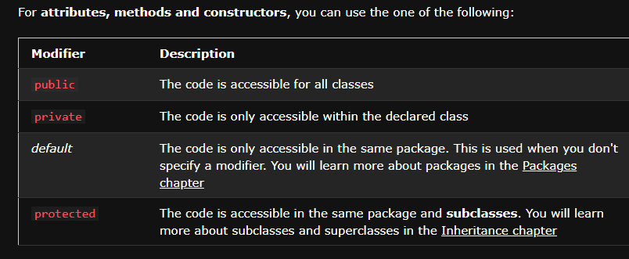

Slide 9
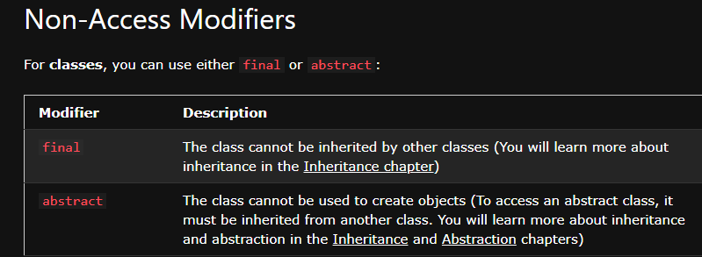

Slide 10
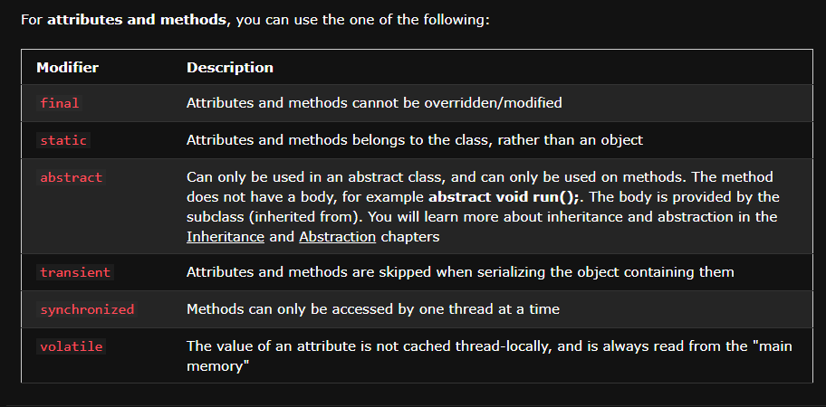

Slide 11
Encapsulation
The meaning of Encapsulation, is to make sure that "sensitive" data is hidden from users. To achieve this, you must:
declare class variables/attributes as private
provide public get and set methods to access and update the value of a private variable

Slide 12
Get and Set
You learned from the previous chapter that private variables can only be accessed within the same class (an outside class has no access to it). However, it is possible to access them if we provide public get and set methods.
The get method returns the variable value, and the set method sets the value.
Syntax for both is that they start with either get or set, followed by the name of the variable, with the first letter in upper case:

